Slide 1
MAKING THE CUT WITH CRISPR

Slide 2
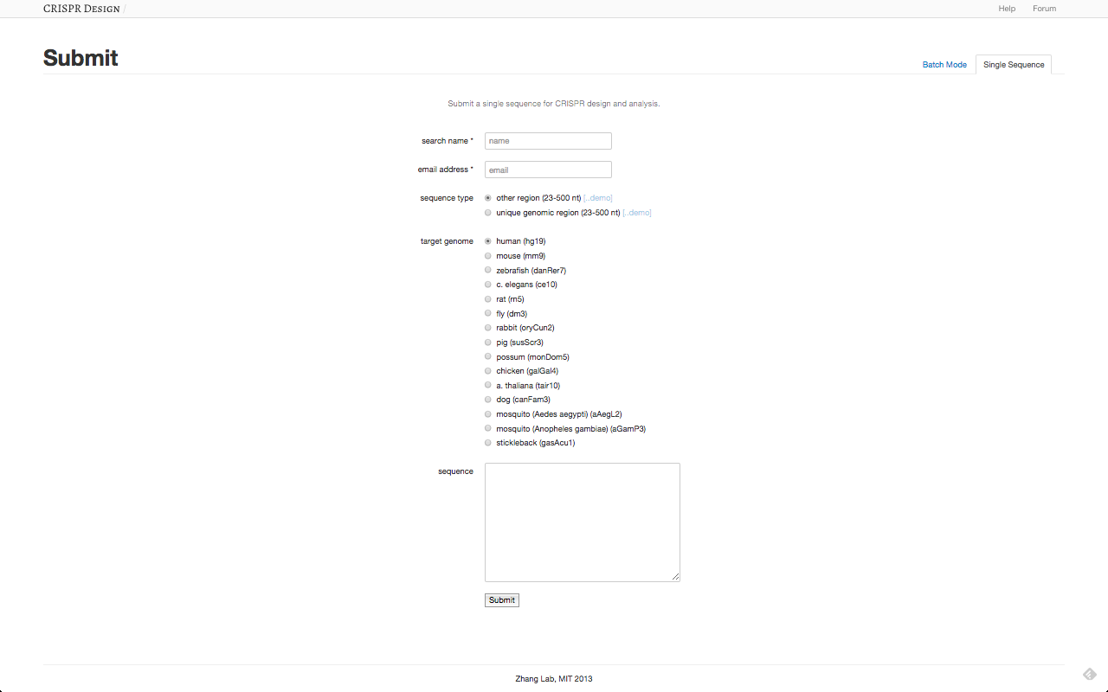
WHY SHOULD CRISPR LOOK LIKE THIS?

Slide 3
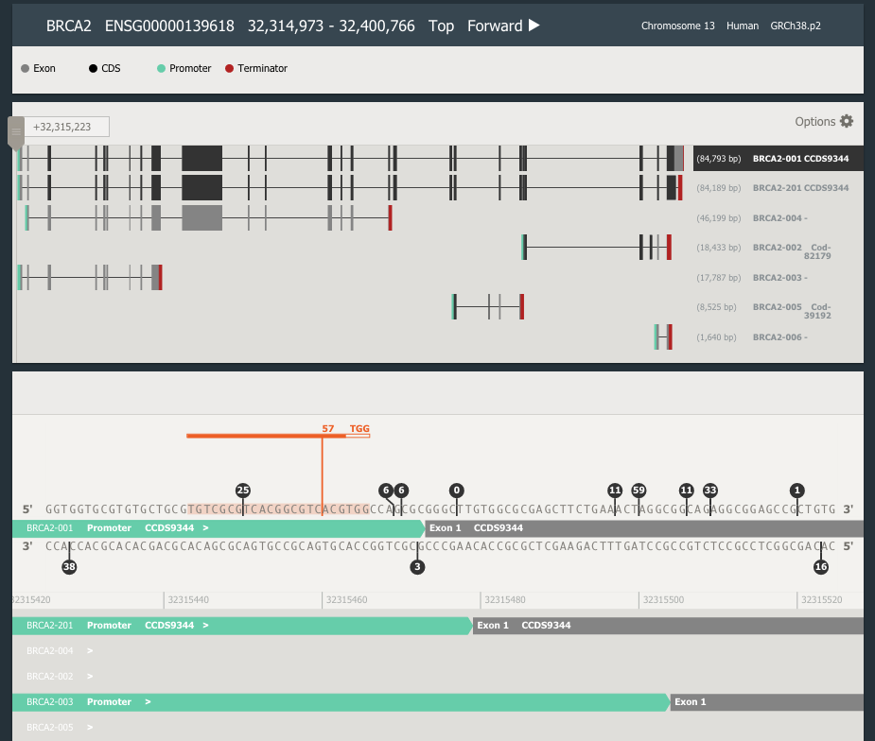
WHEN IT COULD LOOK LIKE THIS?

Slide 4
AGENDA
Brief intro to Desktop Genetics
CRISPR genome editing overview
Considerations in CRISPR design
Hand-on Demo
Q&A

Slide 5

DESKTOP GENETICS
COMPANY SNAPSHOT
London-based software company founded 2012:
Enabling “literal Desktop Genetics”
Giving biologists the tools to edit any gene with ease
Our expertise:
Visualisation | UX Design
DNA Search | DNA Assembly | Genome Editing

Slide 6

DESKGEN PLATFORM
DESIGN ANY GENOME EDITING EXPERIMENT FROM YOUR DESKTOP
FREE SOFTWARE FOR ACADEMICS
COMMERCIAL SUBSCRIPTIONS
ADVANCED GENOMIC SERVICES

Slide 7




WHO WORKS WITH US
PARTNERS AND COLLABORATORS BENEFITING FROM THE PLATFORM
Genome editing company, Cambridge UK
Internal cell line engineering tool
Academic-facing “gUIDEbook”
CRISPR therapeutic company, Cambridge MA
Design and assess the specificity of CRISPR-based therapeutics
Microorganism engineering Cambridge, MA
DNA search engine and automated cloning algorithms
Cancer research center Madrid, Spain
Design libraries for cancer pathway mapping

Slide 8
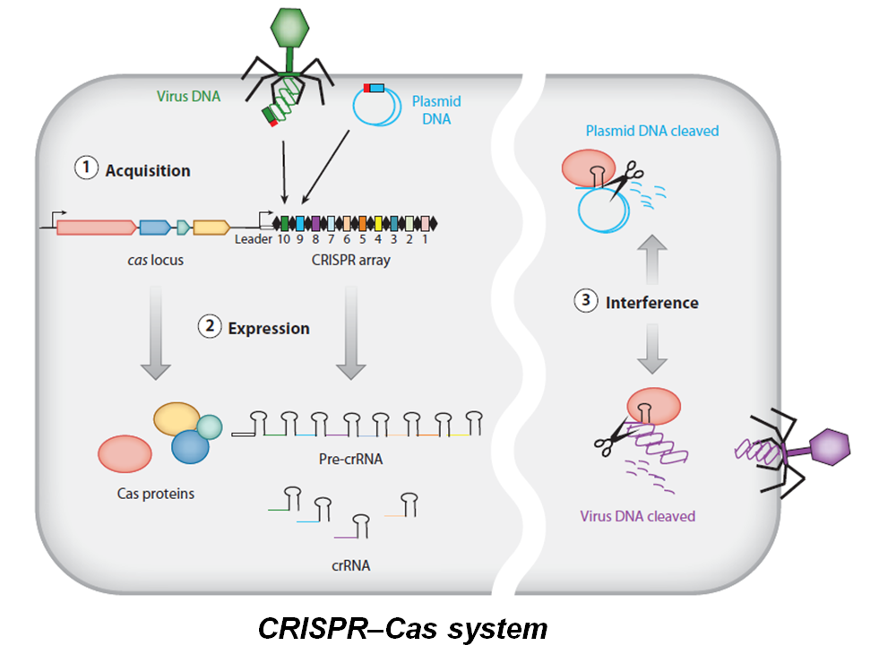
CRISPR IS A BACTERIAL IMMUNE SYSTEM
WE’VE LEARNED HOW TO HIGHJACK IT

Slide 9
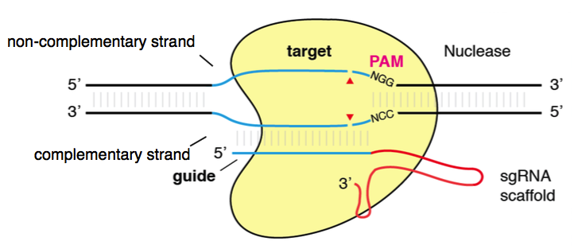
ANATOMY OF A CUT
S. PYOGENES CAS9 CUTS GENOME UPSTREAM OF “NGG” MOTIF
Two cutting domains:
HNH
RuVC
Constant scaffold for Cas9 binding
Jinek et al., Science 2012
Hsu et al., Nature 2013

Slide 10
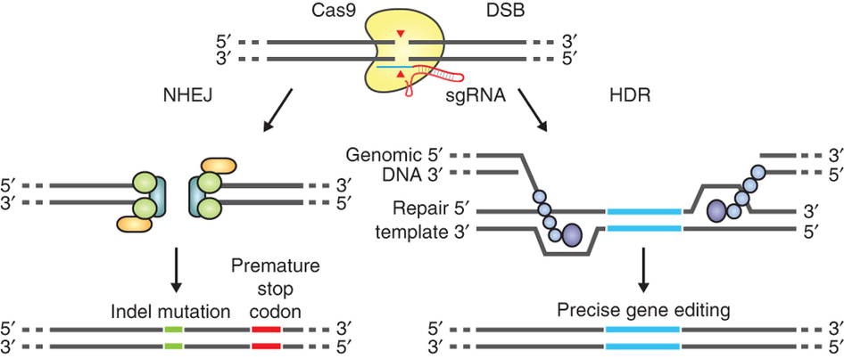
GENOME EDITING MECHANISMS
USING THE CELL’S REPAIR PATHWAYS TO ENGINEER THE GENOME
Double Stranded Break
Non Homologous
End Joining (NHEJ)
Homology Directed Repair (HDR)
HIGH FREQUENCY
ERROR-PRONE
LOW FREQUENCY
HIGH FIDELITY

Slide 11
GENOME EDITING TECHNIQUES
CRISPR IS A RAPID AND EFFECTIVE GENOME ENGINEERING METHOD
 | Zinc Finger Nuclease | TAL Effector Nuclease | CRISPR
Programmable | Protein | Protein | DNA
Engineering | Complex | Complex | Easy
Specificity | Med | High | Med/High
Multiplex | No | No | Yes
Species | Few | Few | Many

Slide 12
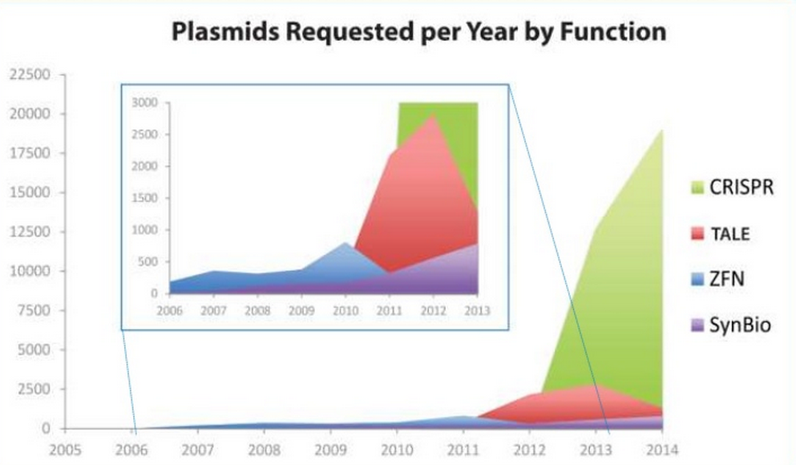
ACCESSIBLE AND WIDESPREAD
RAPIDLY ADOPTED TECHNOLOGY – REQUESTS FROM ADDGENE
Source: http://www.blog.addgene.org/trends-in-crispr-and-synbio-technologies-slideshare

Slide 13
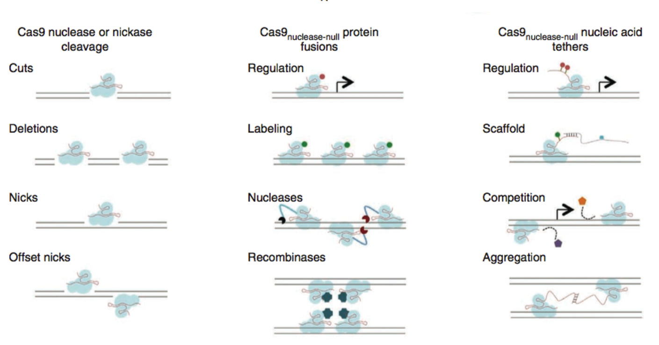
APPLICATIONS OF CRISPR/CAS9
VERSATILE TOOL GOES BEYOND CUTTING DNA
Mali et al., Nature 2013

Slide 14
CONSIDERATIONS OF EXPERIMENTS
IT ALL STARTS WITH THE DESIGN OF GUIDE RNAS
Experimental intent
Accurate data models
Off-target activity
On-target activity
Delivery technique

Slide 15
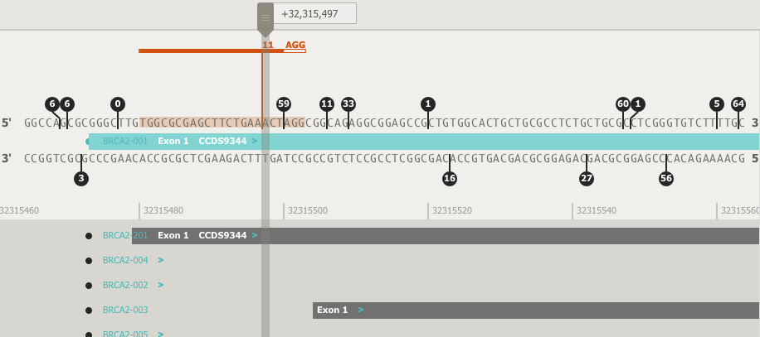
EXPERIMENTAL INTENT
WHAT DO I WANT TO DO?
Experimental intent determines genomic location:
KNOCK-OUT → prefer 5’ targeting
KNOCK-IN → cut within ~30 bp of foci
ACTIVATE → target within 200bp 5’ of TSS
INHIBIT → target ± 200bp around TSS
Always consider all transcripts and coding / non-coding regions
GENOMIC CONTEXT MATTERS

Slide 16
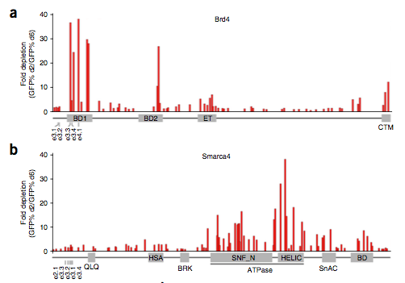
DESIGNING GUIDES
THE MORE YOU KNOW ABOUT YOUR TARGET, THE BETTER
GENOMIC CONTEXT MATTERS
Shi et al., Nature Biotechnology 2015

Slide 17
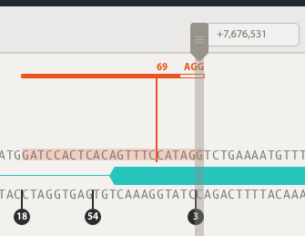
REFERENCE VS ACTUAL GENOME
SNPs can result in widely different gRNA activity
TP53
Reference -> Real Genome
Sequence | SNP location | Activity score
G -> A | PAM site | 0.69 -> 0.00
chr17: bp 7676532 rs1800369
G>A
-100% ACTIVITY DIFFERENCE
Notes:
EVERY NUCLEOTIDE COUNTS

Slide 18
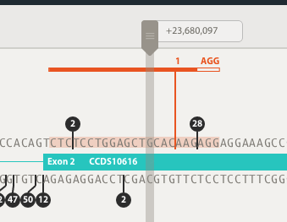
REFERENCE VS ACTUAL GENOME
SNPs can result in widely different gRNA activity
PLK1
Reference -> Real Genome
Sequence | SNP location | Activity score
G -> A | Seed region | 0.01 -> 0.05
chr16: bp 23680098 rs547328721
G>A
+5X ACTIVITY DIFFERENCE
Notes:
EVERY NUCLEOTIDE COUNTS

Slide 19
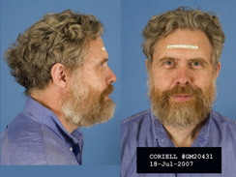
REFERENCE VS ACTUAL GENOME
CONCLUSION
“USE THE ACTUAL GENOME OF YOUR CELL LINE AND NOT THE REFERENCE GENOME”
- George Church -
personalised genome editing

Slide 20
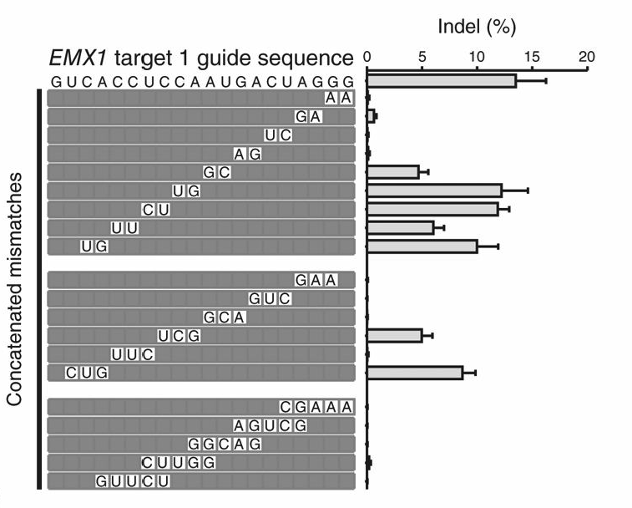
CRISPR SPECIFICITY
WHERE ELSE MIGHT MY GUIDE CUT?
Cas9 is tolerant of RNA-DNA mismatches (up to 6 shown)
Score range:
0 (low specificity)
100 (high specificity)
Important:
Consider locus of off-target
Scan entire genome
Hsu et al., Nature 2013

Slide 21
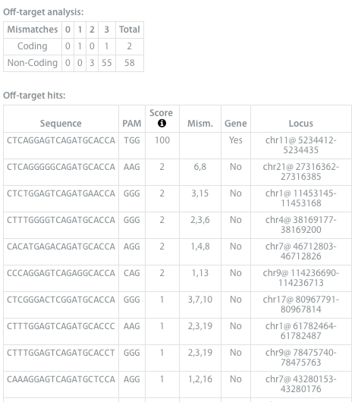
CRISPR SPECIFICITY
IT’S NOT “IF” BUT “WHERE” THAT MATTERS
Example output of DESKGEN off-target analysis:
1
DO I CARE?
How “RISKY” is this guide?
2
WHERE else does this cut?
Do I care?

Slide 22
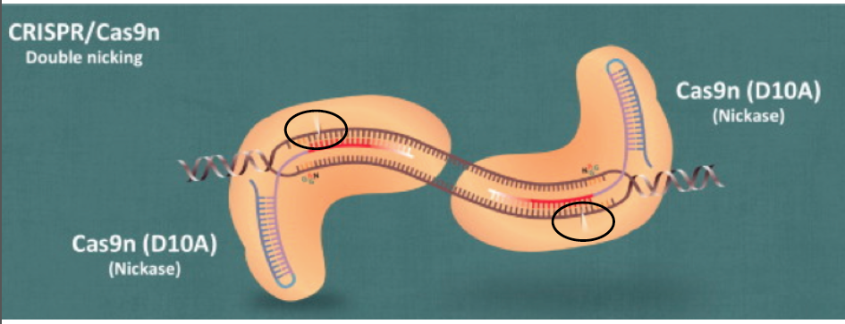
INCREASING SPECIFICITY
NICKASE PAIRS WITH D10A
REDUCED OFF-TARGET
REDUCED EFFICIENCY

Slide 23
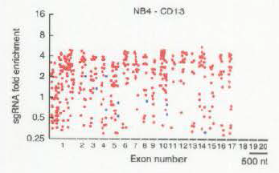
ON TARGET ACTIVITY
HOW WELL WILL MY GUIDE CUT?
Activity score indicates probability a cut will occur
Score range:
0 (low activity)
100 (high activity)
Derived from machine-learning analysis trained on 1,841 guides
NOT ALL GUIDES
ARE CREATED EQUAL
Doench et al., Nature 2014
Notes:
Now you’ve found a guide that cuts and is very specific. How well will it cut? What is the efficinecy of where it will happen.

Slide 24
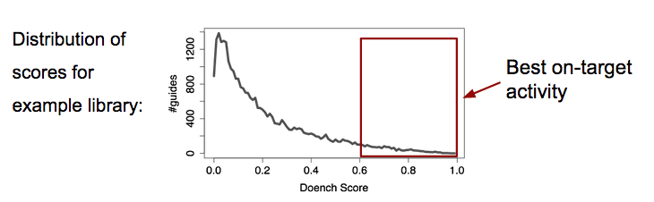
ON TARGET ACTIVITY
NOT ALL GUIDES ARE CREATED EQUAL
Source: internal project, Desktop Genetics

Slide 25
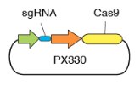
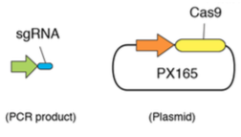
DELIVERY TECHNIQUES
DELIVERING DNA
PLASMID
Single construct
Higher efficiency
Extended time to cutting & increased toxicity
More events: on-target and more off-target
PCR AMPLICON + CAS9
Co-transfect PCR amplicon with Cas9 plasmid
Higher throughput
Two construct system

Slide 26
DELIVERY TECHNIQUES
OTHER DELIVERY MECHANISMS
PRE-TRANSCRIBED mRNA
Co-transfect RNA of Cas9 & gRNA /scaffold
Reduced toxicity, faster effect, more transient effect
CAS9 PROTEIN COMPLEXED WITH gRNA
Rapid cutting activity observed
Reduced delivery into cell, reduced on-target cutting
VIRAL DELIVERY
Typical approach for targeting cells in vivo
Lentiviral packaging
Bioproduction element
Payload may be too large with S. pyogenes
Smaller Cas9 orthologues required

Slide 27
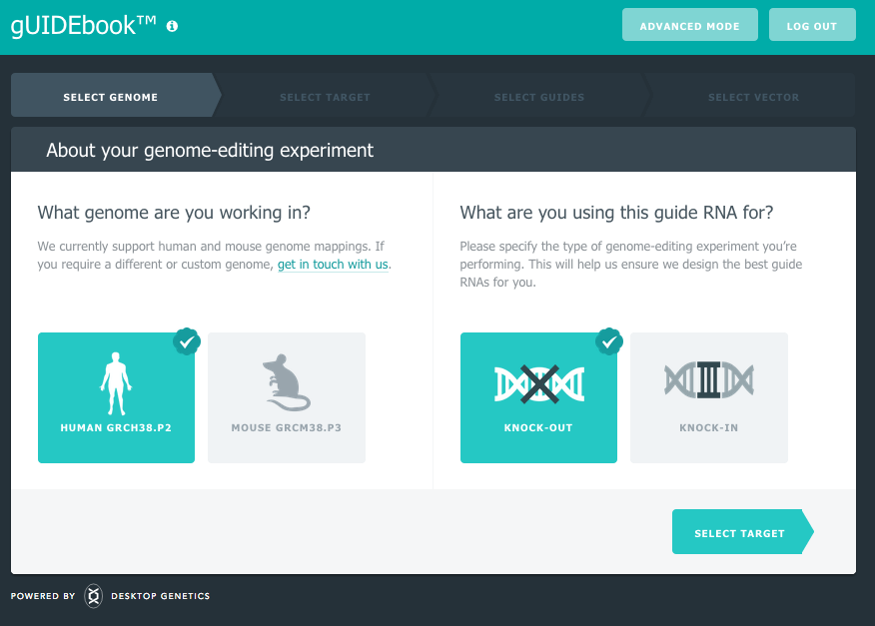
HANDS-ON DEMO
WWW.DESKGEN.COM

Slide 28
COLLABORATE & LEARN
WWW.DESKGEN.COM

Slide 29
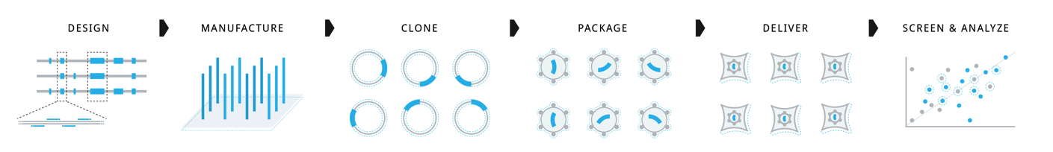




CUSTOM LIBRARIES
ONE STOP SHOP FOR CUSTOM CELL LINE SPECIFIC LIBRARIES
You own library – design → data
Pooled or arrayed
Additionally:
TET inducible promoters
sgRNA-Cas9 lentiviral vector containing fluorescence reporters

Slide 30
EDWARDP@DESKGEN.COM
WWW.DESKGEN.COM

Slide 31
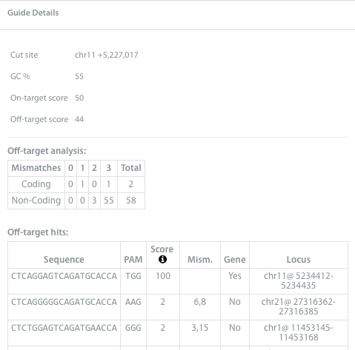
GUIDE DETAILS
EXPLANATION OF GUIDE RNA INFORMATION
GC%
Stay within 20-80%
ACTIVITY SCORE
Doench et al., 2014
0 (low activity)
100 (high activity)
OFF-TARGET SCORE
Hsu et al., 2013
How the score is calculated:
1. Start at 100 (very specific)
2. Subtract all off-target sites scores
0 (low specificity)
100 (high specificity)

Slide 32
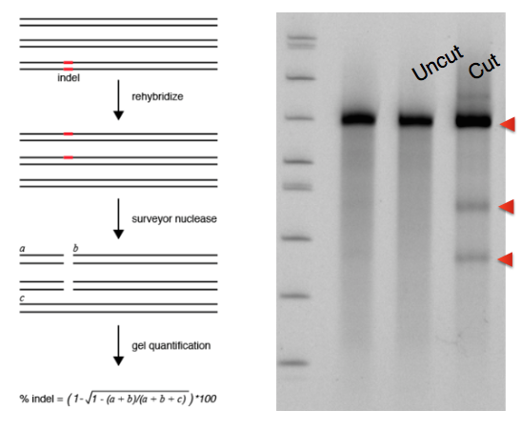
DATA READOUT: SURVEYOR ASSAY
500-800bp GENOMIC PCR
CLEAN UP
MELT & RE-ANNEAL
DIGEST with SURVEYOR nuclease
RUN on a GEL
QUANTIFY
FRAGMENT C = 650bp
(size of PCR product)
FRAGMENT B = 370bp
FRAGMENT A = 280bp

Slide 33
DESKGEN PLATFORM IS UNIQUE
COMPREHENSIVE AND PERSONALISED CRISPR DESIGN
 | Off-target | Activity | Knock-In | Genomic data | Vector construct. | Nickase pairs | # Genomes
DESKGEN | X | X | X | X | X | X | ANY
Chopchop | X * |  |  |  |  |  | 10+
E-crisp | X * |  |  |  |  | X | 10+
Crispr-design | X * |  |  |  |  | X | 10+
Cosmid | X * |  |  |  |  |  | 2
Benchling | X * | X |  | X |  | X | 10
Sgrna Designer |  | X |  |  |  |  | 2
Crispr-era | X* | X |  |  |  |  | 2
* = Heurstics based, NOT comprehensive or exhaustive search

